Slide 1

APARTMENT
BOOKING MANAGEMENT SYSTEM
USING JAVA

Slide 2

ABSTRACT:
The Apartment Booking Management System (ABMS) is a Java-based application designed to streamline the process of managing apartment bookings for rental agencies or property managers. The system provides a user-friendly interface for both administrators and customers, offering functionalities such as apartment listing, booking ement, payment processing, and reporting.

Slide 3
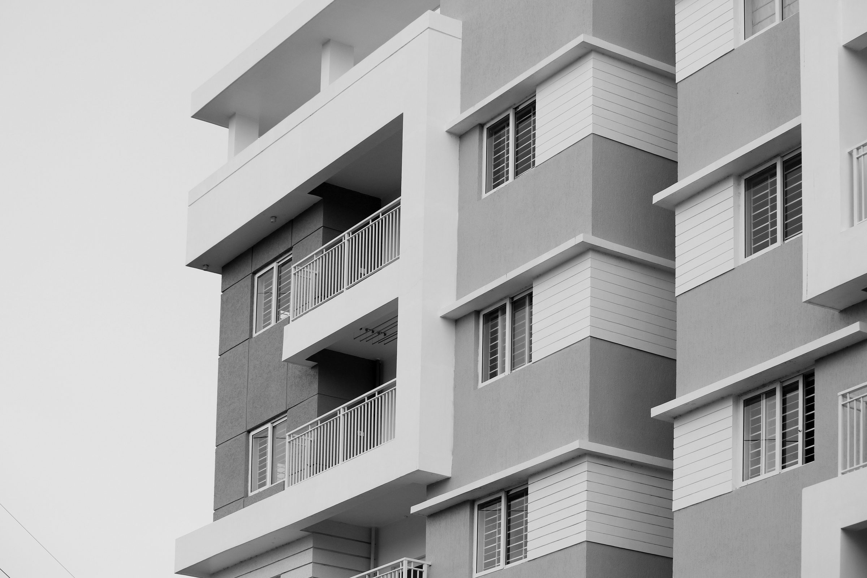
FEATURES:
BOOKING MANAGEMENT
PAYMENT PROCESSING
RESERVATION CONFIRMATION
REPORTING AND ANALYTICS

Slide 4

CONCEPTS USED IN OUR PROJECT :
Conditions and
If Statements :
In a program, a conditional statement can be used practically to determine whether a user input meets certain criteria before proceeding with further processing.

Slide 5
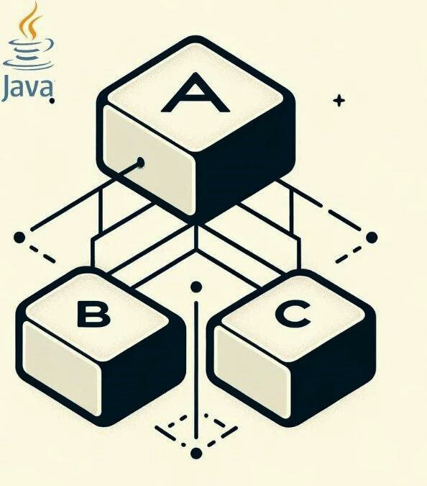
CONCEPTS USED IN OUR PROJECT :
Inheritance :
(Multi-level Inheritance)
In practical programming scenarios, multiple inheritance can be utilized to create classes that inherit attributes and methods from more than one parent class.

Slide 6
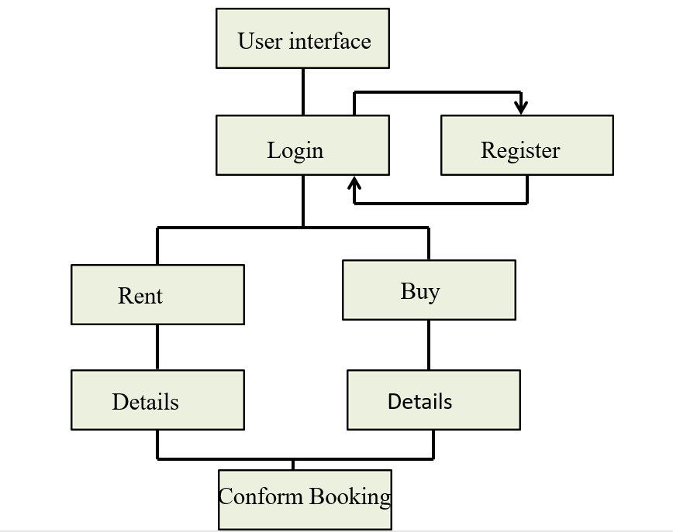
FLOW CHART

Slide 7



